Slide 1


Creating your business process:
Client Journey
Dominika Sieradzka
Practice Management Consultant

Slide 2


Your feelings around 'process’
What does the word ‘process’ mean to you?
Do you see yourself as an integral part of your business process?

Slide 3

Process = Clarity

Slide 4

Lack of process = Chaos

Slide 5

Common symptoms
Lack of consistency
Lack of scalability
Long turnaround times
Firefighting
Lack of accountability
Uneven distribution of workload
Suboptimal communication re client work
Complex operations
Lack of clarity

Slide 6

Businesses implement processes:
To create an excellent & consistent client experiences delivered in a timely manner
To create scalability
To remove complexity
To create a stimulating & enjoyable working environment
To reduce risk
To create accountability
To improve predictability
To protect your brand

Slide 7

Can you name a single successful business that doesn’t have a process in place?

Slide 8

Successful businesses have clarity on 6Qs
What?
(task/activity, philosophy, service standards & offering)
Who?
(accountability)
Why?
(reason/purpose)
When?
(specific time-frames)
at every step of the way!
How?
(processes, procedures, tools, templates)
Where?
(location)

Slide 9


Does McDonald’s have clarity on 6Qs?
What? How? Why? Who? When? Where?

Slide 10

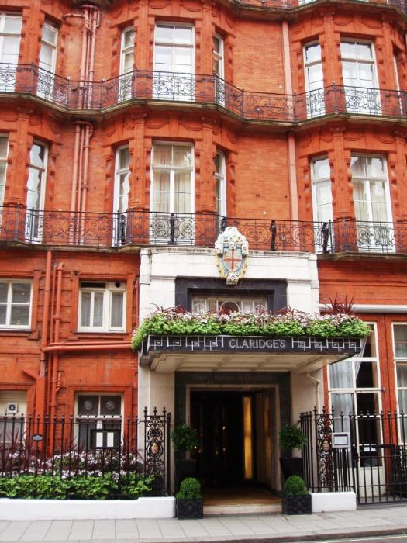

What about Claridge’s?
What? How? Why? Who? When? Where?

Slide 11

The most common trap
Making EXCEPTIONS
Introduces complexity
Creates inefficiency, and
Potential for errors
Lack of consistency in client experience
Lack of scalability

Slide 12


Slide 13

Can you guess what is the most commonly used process across financial planning firms?

Slide 14
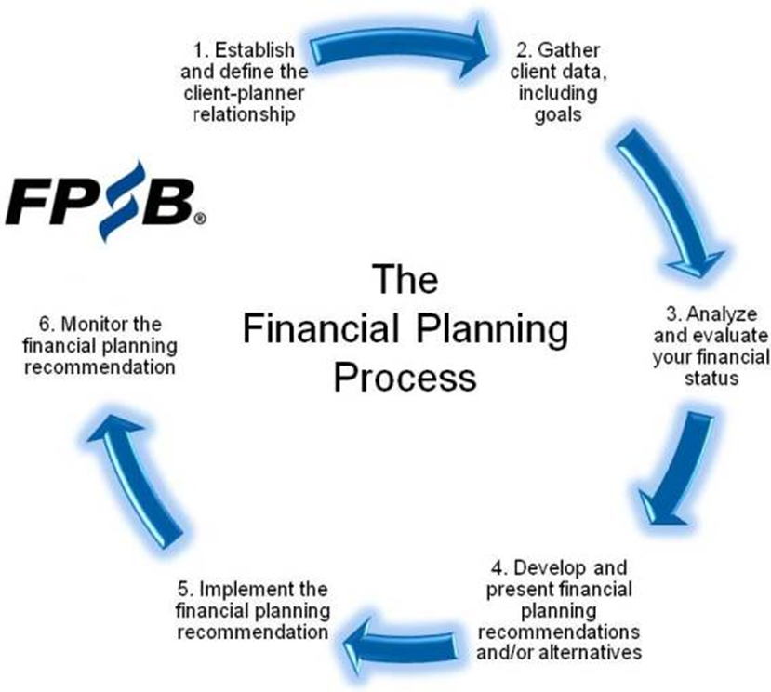
IFP’s six step
‘Discover
the difference’
process developed
in 2014

Slide 15
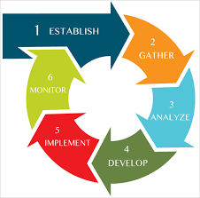
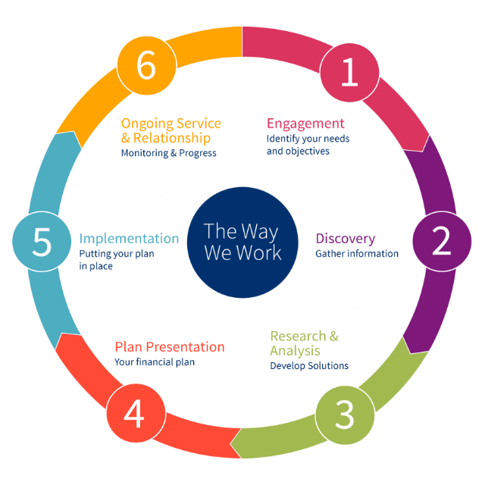
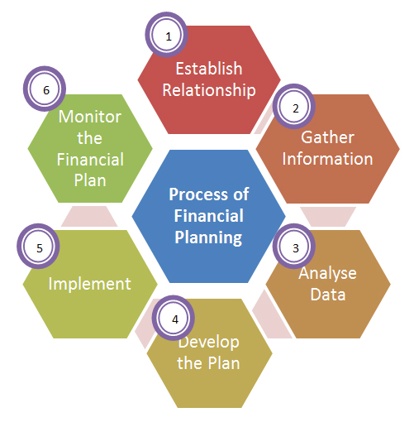
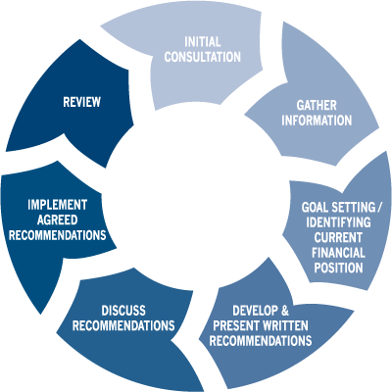
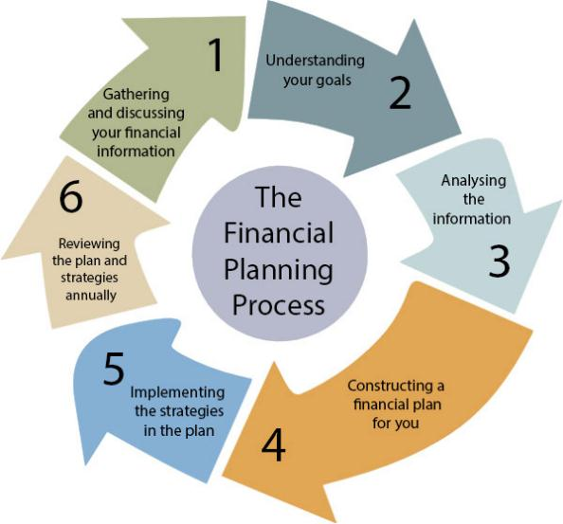
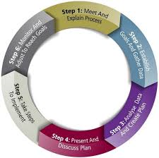
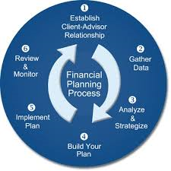

Slide 16
Which stage of this process can be the least pleasant for both advisers & clients?

Slide 17

How do you currently go about fact finding?
Adviser completes a paper based questionnaire
Client completes a paper based questionnaire
Client completes a word document or editable PDF
Fact find is completed via the phone
There are bits of paper that contain important information collated during various meetings

Slide 18
Can technology created a better client experience?
https://dominikafp.advicefront.com/onboarding/form
https://dominikafp.advicefront.com/profile/about_you

Slide 19

What are your thoughts on what you have seen?
How does this compare to your current process?

Slide 20
Advantages | Disadvantages
Easy to use Requests only relevant info one page at the time Time efficient Cost efficient Relatively painless Information is accessible immediately upon completion Easy to amend at any time point | Requires access to Internet Not for everyone Typically easier to engage with for younger clients

Slide 21

The are numerous ways of delivering the 6 step process
As are many ways of defining What? How? Why? Who? When? Where?
Have you got a documented version of your 6Qs for your client journey?

Slide 22
Example
Client Journey Flow

Slide 23
Initial client contact
Discovery meeting (2nd)
Implemen. Meeting (4th)
10 day lead
Call to organise meeting 2-3 weeks later
2 week lead
Same day
Within 24hrs of completion
3 - 6 weeks
Screening Call
Check-in call
Strategy Meeting (3rd)
Min 5 day lead
Client homework
Approx. 12 months
4 days
Review
Initial Meeting (1st)
Strategy Report

Slide 24

Let’s begin with your
Annual Review Process

Slide 25
Example Annual Review Process
Issue client notification
Ring client to organise meeting
Confirm client review
3 days after
Min 6 weeks lead
Prepare client review
6 weeks prior to review
Prepare valuation & other rev. docs
Update cash flow & prep. tech. info
Debrief with FP
Complete 2 weeks prior to meeting
Complete 1 week prior to meeting
1 week prior to meeting
24hrs prior to meeting
Follow up letter
Annual Review Meeting
Finalise Annual Review Pack
24hrs post meeting

Slide 26

How to ensure that your process succeeds?
By creating
an exceptional team!

Slide 27

How to create an ideal team?
Stage 1: Gain clarity
Stage 2: Create an ideal organisational structure
Stage 3: Formalise roles & responsibilities
Stage 4: Identify who you need
Stage 5: Recruit ‘the right person’
Stage 6: Identify training needs
Stage 7: Develop a training & career plan
Stage 8: Review & evaluate
Stage 9: Give reasons to stay

Slide 28

CLARITY = SUCCESS
Clarity means knowing:
where you want to be (Aims, goals & objectives)
how you want to work
who you want to work with
your own strengths & limitations

Slide 29

What does CLARITY give to your team
Direction
Inspiration
Removes confusion & uncertainty (and hence errors)
Instils confidence in their work & abilities
Ability to plan

Slide 30

Stage 2:
Create an ideal organisational structure
Have you got one?
What does it look like?
What to outsource?

Slide 31
Example

Slide 32
Managing Director/MP
Operations Director/Practice Manager
Financial Planner(s)
Finance Assistant
Marketing Assistant
Compliance Assistant
Paraplanner(s)
HR Assistant
IT Assistant
Client Relationship Manager(s)
Administrator(s)
Junior Admin

Slide 33
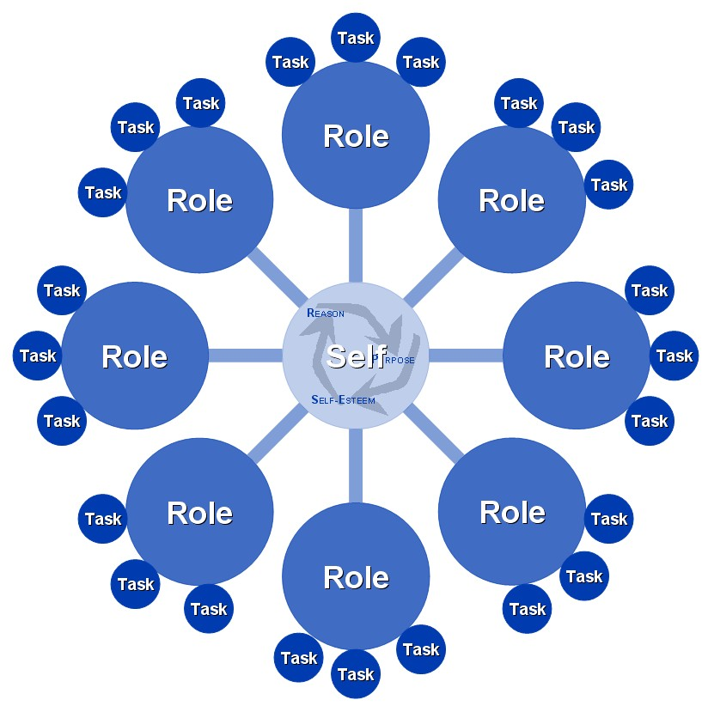
Stage 3:
Formalise Roles & Responsibilities
Create job specs as per your organisational structure
Avoid creation of mixed roles (it’s a trap!)
Be specific (about responsibilities, skills, qualifications and experience needed)
Make sure to align job specs with your business processes e.g. Admin spec – new business processing as per advice process

Slide 34

Stage 4:
Identify who you need
Identify strengths & weaknesses of your team members and overlay with your org. structure
Have you got the right people in the right jobs?
Is the person who would make an excellent Practice Manager currently your Administrator?
Is there a need for re-structuring?
Is there a real need for a new hire?

Slide 35


Stage 5:
Recruitment
Once you have identified a recruitment need make sure to find the ‘right’ person for the job

Slide 36
How to find
the ‘right’ person?

Slide 37

Step-by-step guide to successful recruitment
Consider outsourcing!

Slide 38

An alternative step-by-step guide to successful recruitment
Advertise or carefully choose recruitment consultants to work with
Create a Vacancy Specification based on the job spec
Follow a well defined recruitment process regardless of the role you are recruiting for
DON’T RUSH into things; take your time
DON’T COMPROMISE; you want the ‘right’ person

Slide 39

Example recruitment process
Screen CVs
Telephone interview
1st face-to face interview
2nd face-to-face interview
Offer letter to the successful candidate

Slide 40

Screen CVs
What qualifications & skills does the candidate have? Do these match your requirements?
What experience does the candidate have? Does the experience match your requirements?
How often does the candidate change jobs?
What do I know about the businesses they worked at?
Is there anything that stands out?

Slide 41

Telephone Interview
A must do time saver!
This interview should be the same for all positions and should take no more than 20min
A quick method to get to know candidates:
Who they are
How they think
How they work
What they are likely to be like

Slide 42

1st Face-to-Face interview
Welcome the candidate
Make the candidate feel at ease
Introduce yourself and explain the company interview process
Ask the candidate to briefly walk you through their CV (this will provide a natural opportunity to ask specific details about the things that stand out)
Confirm role details (give an overview of the job spec)

Slide 43
1st Face-to-Face interview Cont.
Select key responsibilities from the job spec and ask for examples of relevant experience and contributions that they would make
Go through a selection of interview questions
Test their technical ability (think of examples of difficult cases)
Establish expected salary, potential start date and any planned holidays or time off
Ask them if they have any questions
Explain the next steps

Slide 44

2nd Face- to- face interview
Make it a much more informal process
Give the candidate further insights into your business over a cup of coffee
Have a relaxed conversation about their aspirations and allow them to ask as many questions as they wish
Show them around the office
Get a few members of your team to join you for a further chat over lunch or a cup of coffee

Slide 45

Consider psychometric testing
It’s a measure of a candidate's personality, assessing traits that will contribute to an individual's performance at work.
It can help with the assessment of:
How well the candidate is likely to integrate into the team?
How they are likely to cope in stressful and demanding environments?
If they can think for themselves
Whether they will really fit into your organisation

Slide 46

After the 2nd Interview
Have a debrief with your team
Listen to their thoughts and comments
Go over the interview notes
Remind yourself of your initial impressions
Make a job offer BUT ONLY IF you feel that you have found the right person for the job!
Don’t rush into things!

Slide 47

Post Candidate Selection
Inform the successful candidate and send out an offer letter
Contact unsuccessful candidates
Obtain references
Create an induction/handover programme
Agree on a start date
Carry out an induction/handover

Slide 49

Key things to remember
Process=Clarity=Success
Go for the BEST & don’t compromise
Hire people that are better than you
Hire the right people for the job
Quality over quantity
Help your team develop further
Make your team feel valued
Give them reasons to stay
Continually review & evaluate

