Slide 1
Uncover
Your Business Potential
Brett Davidson Founder

Slide 2
Review
Of Days 1, 2, 3, 4, 5, 6, & 7

Slide 3
How is your team coming along?

Slide 4
What decisions have you made about your investment proposition?
What action are you taking as a result?

Slide 5
How is initial contact with new prospective clients changing?

Slide 6
Have you done any new first meetings?
(What worked? What still needs a tweak?)

Slide 7
What have you been learning?

Slide 8
The New Client
Engagement Process

Slide 9
The Client Experience
Is it mind blowing?
Inital Contact
Initial Contact - do you make a strong first impression?
First Meeting
First Meeting - is it amazing? or just ok?
Discovery/Fact Find
Discovery/Fact Find - collecting the hard data
Strategy Presentation
Strategy Presentation - showing me how to live happily ever after
Onboarding -
Implementation
Onboarding/Implementation - slick, efficient, with great communication
Referral Opportunity
Referral Opportunity - get all steps right and here’s your next client

Slide 10
1
Initial Contact

Slide 11
First Contact
What’s the purpose of the call?
To ascertain if the prospect meets your minimum criteria
If they do meet your minimum, to get them into your office for a first meeting

Slide 12
2
First Meeting

Slide 13
First Meeting Skills
Getting clients to come and see you in your office:
Saves huge amounts of time
Helps with your positioning
Means you have your ‘tools of trade’ to hand
You make more money

Slide 14
What’s the aim of the First Meeting?

Slide 15
1
For you to understand something of the client’s issues

Slide 16
2
For the client to understand what the real issues are that they face
(which may not be what they came to see you about in the first place)

Slide 17
3
To demonstrate to the client they’ve come to the right place

Slide 18
4
To set up the terms on which you will do business – strongly
(so you can get paid fairly for your expertise)

Slide 19
The Top 10
First Meeting Mistakes

Slide 20
Top 10
First Meeting Mistakes
Talking too much
Using Fact Finder at first meeting
Going for the jugular
Not giving them enough (at the right time)
Fluffing the fee discussion
Committing the client to all 3 phases
Not asking searching and interesting questions
Not listening to the answers
Not recognising the significance of the answers
Doing it all perfectly, but to one person
Did you notice yourself making any of these mistakes?

Slide 21
Homework:
Record one of your meetings and listen back to it

Slide 22
XYZ Financial Advisers

Slide 23
Agenda
1
Who Are
XYZ Financial Advisers?
2
What We Do
3
About You
4
What We Deliver

Slide 24
Who Are
XYZ Financial Advisers?
Boutique financial strategists
Independent
In business for 25 years
A team of highly qualified specialists
Low staff turnover (same faces year in year out)
Strong balance sheet
Licensed by the industry regulator

Slide 25
What is the role of the adviser?
Clearly understand your goals
Develop the right strategy to achieve those goals
Minimise any taxation consequences
Minimise any risks
Provide education regarding investments
Develop an appropriate investment strategy
Monitor progress toward objectives
Review the strategy regularly

Slide 26
Who we work best with?
Business owners
Professionals
Executives
Self made people
People who recognise
there might be a better way

Slide 27
What is financial advice?
A bit like a jigsaw puzzle
A formula
Strategy x tax x investment return x review
= OUTCOME
If any of the factors are zero
what is the outcome?

Slide 28
Tell Me
About You…

Slide 29
What you can expect from us
Telephone calls and emails returned promptly
Access to the ‘XYZ Financial System’
Honest and proactive advice
A focus on results
Practical solutions that work for you
Focus
Results
Value Added

Slide 30
What we expect from you
Input into the process
Telephone calls and emails answered promptly
Paperwork completed and returned ASAP
Questions asked if something doesn’t make sense
Honest feedback on our service
A commitment to working with us going forward
Input
Action
Growth

Slide 31
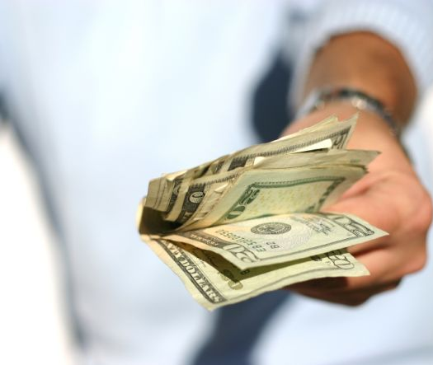
How do we get paid?
TWO WAYS:
1
By Fees
Strategy Fee
Implementation Fee
Ongoing Review Fee

Slide 32
What do the fees cover?
Ownership of the strategy (XYZ’s Intellectual Capital)
Accurate implementation (Professional Responsibility)
The XYZ Financial System
Strategic research & development
Investment research
Ongoing advice (refer XYZ Client Service Standard)

Slide 33
How do we get paid?
TWO WAYS:
2
Via referral
Like attracts like
Reduced marketing expense reduces costs
Time saved is used to add client value

Slide 34
What do you get?
The results:
A bespoke strategy designed to achieve your financial objectives
A range of top quality tools with which to take action
Peace of mind that comes from knowing where you are today
A partnership with a quality firm working on your behalf
“Access to cutting edge strategies that truly deliver”

Slide 35
Any questions?

Slide 36
The next step is up to you
Step 1 : First Meeting
Step 2 : Discovery
Step 3 : Plan Presentation
Step 4 : Checkpoint
Step 5 : Implementation
Step 6 : Ongoing Review

Slide 37
3
Discovery/Fact Find

Slide 38
The Client Experience
Is it mind blowing?
Inital Contact
Initial Contact - do you make a strong first impression?
First Meeting
First Meeting - is it amazing? or just ok?
Discovery/Fact Find
Discovery/Fact Find - collecting the hard data
Strategy Presentation
Strategy Presentation - showing me how to live happily ever after
Onboarding -
Implementation
Onboarding/Implementation - slick, efficient, with great communication
Referral Opportunity
Referral Opportunity - get all steps right and here’s your next client

Slide 39
Discovery/Fact Find
Do it as a separate step - why?
Delegate the process to a team member if you can
This one might need to be flexible
(depends on client and circumstances)
This is the most annoying step of the process
How can you make it painless?

Slide 40
Discovery/Fact Find
The expenditure questionnaire - four types of clients
The ‘detail’ person
The ‘good’ client
The ‘slapdash’
The ‘time poor’

Slide 41
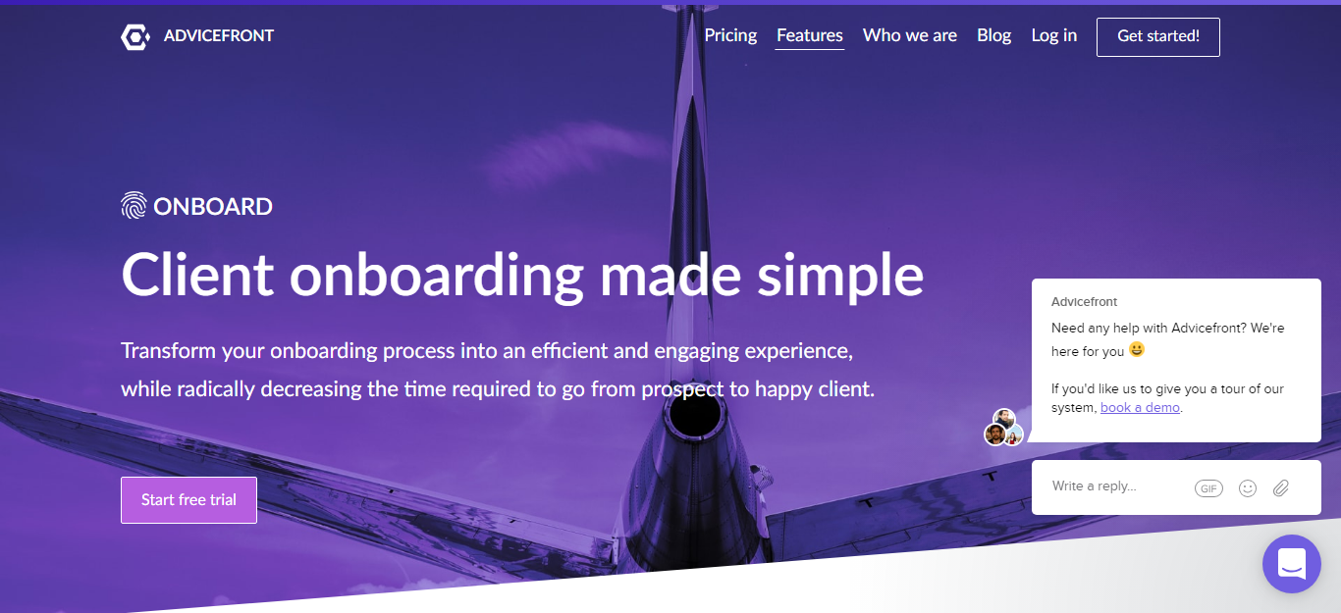
https://advicefront.com/features

Slide 42
This is the place
to get the risk profile questionnaire completed...
(with all the other data)

Slide 43
...and to talk about the implications
of their risk profile choices

Slide 44
When should you cover off your investment philosophy?

Slide 45
Here would be
a good place
at the Discovery Meeting
(but there are other options)

Slide 46
Investment Philosophy
Could be covered off in any of these places:
At the First meeting with a new client
At the Discovery meeting
At the Plan Presentation meeting
At the Checkpoint meeting (or call)
At the Implementation meeting

Slide 47
Your Investment Philosophy needs to be packaged in Powerpoint
(for use as and when required)

Slide 48
XYZ Financial Planning
Investment Philosophy

Slide 49
1. The importance of process
What does process give you?
 | Good outcome | Bad outcome
Good process | Deserved success | Bad break
Bad process | Dumb luck | Poetic justice
Source: J. E. Russo, P. J. H. Schoemaker, (2002), Winning Decisions, New York: NY Doubleday.
Confidence
Comfort
Conviction

Slide 50
2. Don’t try and be a fund manager – be a risk manager
Quick exercise
ACCEPT
AVOID
RISK
REDUCE
TRANSFER

Slide 51
3. Defining the construction process
Return
Growth assets
Defensive Assets
Risk

Slide 52
You can’t trust the data
Data: John C. Bogle, (2007) The Little Book of Common Sense Investing, J Wiley & Sons, pp. 80-81
US equity fund data from 1970-2005.

Slide 53
4. Incoming client portfolio analysis
Just because he got away with it doesn’t mean it wasn’t risky!

Slide 54
5. Selecting the most suitable mix for you
Balancing ownership and lending
Return
Growth assets
Your portfolio?
Your financial need to take risk to meet your goals
Defensive assets
Risk
Your emotional tolerance to and financial capacity for risk

Slide 55
4
Strategy Presentation

Slide 56
The Client Experience
Is it mind blowing?
Inital Contact
Initial Contact - do you make a strong first impression?
First Meeting
First Meeting - is it amazing? or just ok?
Discovery/Fact Find
Discovery/Fact Find - collecting the hard data
Strategy Presentation
Strategy Presentation - showing me how to live happily ever after
Onboarding -
Implementation
Onboarding/Implementation - slick, efficient, with great communication
Referral Opportunity
Referral Opportunity - get all steps right and here’s your next client

Slide 57
Do the technical work.
What are your recommendations based on your research?

Slide 58
Build a cashflow model:
Plan 1
Clients Current Position
- how does that work out?
Plan 2
Your first ideas
Plan 3, 4, 5 etc
Other options

Slide 59
How do you want clients to feel
after you give them
your advice?

Slide 60
So, how will you present your advice?

Slide 61
Storytelling - The Hero’s Journey

Slide 62
Storytelling - The Hero’s Journey
How can you re-create this in your strategy meeting presentation?
Here’s where you are now (cashflow model)
Here’s where you said you wanted to get to (from great questions)
There’s a dragon we have to slay (will we make it?)
I’ve slayed it for you - my strategy
Now you can live happily ever after

Slide 63
Don’t use a written report
(In fact, don’t give the client a written report at recommendation time)

Slide 64
Present the strategy as a series
of Power Point slides

Slide 65
Recommended Strategy - How You Get There
Recommendation 1 - Sell Majorca, pay off any debt and inject the net proceeds into your company
Sell Holiday Home In Majorca
£600,000
Repay Bank Loan
£300,000
Inject Net Proceeds Into Your Business
£300,000
(clearing Directors Loans)
Reason Why:
Clear the £60,000 of Directors loans in your company - cleans up an annoying issue
Creates free cash to enable tax deductible contribute to your pension funds

Slide 66
Recommended Strategy - How You Get There
Recommendation 2 - Make Sell Majorca, pay off any debt and inject the net proceeds into your company
Your Company
£240,000
Mary’s Pension
£120,000
Flexible Tax Effective Retirement Income
Bill’s Pension
£120,000
Reason Why:
Creates a tax deduction for your company
Sets up a flexible tax effective income for when you retire next year

Slide 67
Present Voyant cashflow
LIVE ON SCREEN

Slide 68
Do it slowly!
Clients can’t understand any of what shows on screen at first

Slide 69
Explain the strategy
using these tools and verbally
(Discus options and alternatives as appropriate)

Slide 70
Follow up
post meeting with an email
(What needs to happen next and the outcomes you expect)

Slide 71
Client then makes a decision

Slide 72
Confirm via email
“This is what we’re doing”

Slide 73
Then create the Suitability Report
(for the one final strategy)

Slide 74
5
Onboarding/Implementation

Slide 75
The Client Experience
Is it mind blowing?
Inital Contact
Initial Contact - do you make a strong first impression?
First Meeting
First Meeting - is it amazing? or just ok?
Discovery/Fact Find
Discovery/Fact Find - collecting the hard data
Strategy Presentation
Strategy Presentation - showing me how to live happily ever after
Onboarding -
Implementation
Onboarding/Implementation - slick, efficient, with great communication
Referral Opportunity
Referral Opportunity - get all steps right and here’s your next client

Slide 76
Onboarding/Implementation
What’s the key to a great onboarding experience?
Communication - frequent and clear
Failure to do this makes me feel I was sold
Your admin team can do this
(if they have a customer service mindset and can speak on the phone, or can write nice emails)
This is another step that can earn you a bunch of referrals (or not)

Slide 77
Onboarding/Implementation
Here’s how the client can feel when it’s done badly:
I came and saw this adviser who seemed competent and a nice person
They showered me with energy and affection for a couple of months to get my business
I just cut them a cheque for a lot of money (my life savings in fact)
Now it's all done I haven't heard from them for 3 or 4 weeks
Mmm

Slide 78
What does
a great onboarding process look like?
(refer handout)

Slide 79
Communication Process
Week 1:
Communication Method : Email
Person Responsible : CRM
“All paperwork has been sent off to XYZ Wrap provider. We’ll keep you updated as monies are received from your existing pension fund and are invested.
We also lodged the application for your income protection cover with ABC Insurance Company and will let you know any next steps or requirements from them as soon
as we hear anything.”

Slide 80
Communication Process
Week 2:
Communication Method : Text message
Person Responsible : CRM
“Just to let you know, we haven’t received anything yet from your existing pension
provider, but I spoke to them and they confirmed receipt of our withdrawal request.
Also, ABC insurance company has requested a medical and blood test as we
expected. I’ll call you this week to arrange a time and venue that’s convenient for you.”

Slide 81
Communication Process
Week 3:
Communication Method : Text message
Person Responsible : CRM
“Still no monies received from your existing pension, but I have been on the phone to them twice this week hustling things along.”

Slide 82
Communication Process
Week 4:
Communication Method : Phone call
Person Responsible : Adviser
“These sorts of time frames are a pain, but certainly not unusual. I can assure you my team have been engaging in a coordinated programme of harassment directed toward the offending company.”

Slide 83
Communication Process
Week 5:
Communication Method : Email
Person Responsible : CRM
“Some good news; we have received a first payment from your existing pension of
£187,000. This was received today and will be invested today into a selection of the
recommended funds discussed in your financial plan. We are hoping to receive the
outstanding balance (£359,000) by Monday. But I’ll confirm receipt and re-investment with you early next week.”

Slide 84
The final phone call on completion
(Opportunity for referral)

Slide 85
Communication Process
On Completion:
Communication Method : Phone call
Person Responsible : Adviser
“Welcome aboard. It’s really great to have you as a client and I’m looking forward to working with you. If there any issues that come up and you want to drop me an email or set up a quick chat, feel free to get in touch.”

Slide 86
The Client Experience
Is it mind blowing?
Inital Contact
Initial Contact - do you make a strong first impression?
First Meeting
First Meeting - is it amazing? or just ok?
Discovery/Fact Find
Discovery/Fact Find - collecting the hard data
Strategy Presentation
Strategy Presentation - showing me how to live happily ever after
Onboarding -
Implementation
Onboarding/Implementation - slick, efficient, with great communication
Referral Opportunity
Referral Opportunity - get all steps right and here’s your next client

Slide 87
Doing an amazing job at every step requires some work

Slide 88
Doing an amazing job...
is the sexiest and cheapest form of marketing known to humankind

Slide 89
When we cover off the marketing day,
you’ll understand why.

Slide 90
The Client Experience
Is it mind blowing?
Inital Contact
Initial Contact - do you make a strong first impression?
First Meeting
First Meeting - is it amazing? or just ok?
Discovery/Fact Find
Discovery/Fact Find - collecting the hard data
Strategy Presentation
Strategy Presentation - showing me how to live happily ever after
Onboarding -
Implementation
Onboarding/Implementation - slick, efficient, with great communication
Referral Opportunity
Referral Opportunity - get all steps right and here’s your next client

Slide 91
Refer to Client
Journey handout

